Slide 1
VIZ1, Session 2
Visual Encodings of Data

Slide 2
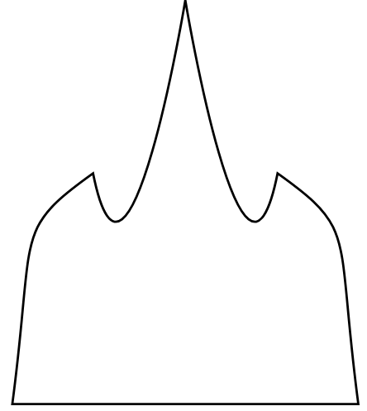
How did it go?
<path d="M 100 500
c 20 -150, 0 -150, 70 -200
c 30 150, 80 -150, 80 -150
c 0 0, 50 300, 80 150
c 70 50, 50 50, 70 200
z"
fill="none"
stroke="black"
stroke-width="2" />

Slide 3
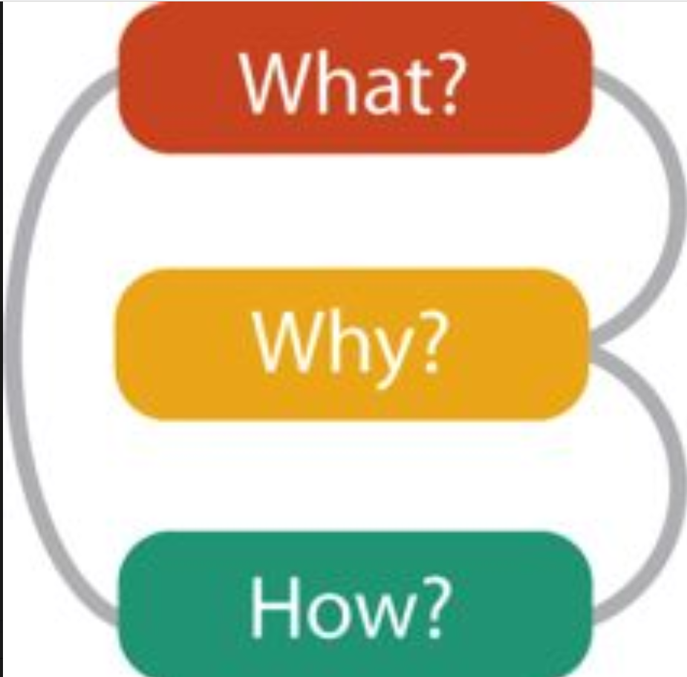
The what, the why, and the how

Slide 4
The What: Data types
Items
Samples, objects, rows, nodes in a graph, …
Attributes
of items
Links
Not hyperlinks - edges of graphs or trees
Positions
Geographical, spatial 2D, spatial 3D
Grid
Collections of positions with underlying geometry or topology

Slide 5
The What: Dataset types
Tables
Rows of items identified by a key, columns of attributes
Networks
Graphs: Nodes and links
Fields
Items sampled from a continuous domain. (The key is continuous.)
Geometry
Spatial fields. Usually geographical.
Multi-dimensional tables
Items identified by 2 or more keys

Slide 6
The What: Attribute types
Categorical
Discrete, unordered data
Names, colours, gender, species, manufacturer, …
Ordinal
Discrete, ordered data
Shirt sizes, grades, floors, dates, …
Quantitative
Continuous, ordered data
Revenue, medical data, prices, …

Slide 7
The Why
Ask people what they need, and you will get all kinds of answers
Task abstraction is about turning it into language we can translate into visual elements
Example:
They: "I want to see how ice cream sales are influenced by the temperature"
We: "You want to discover trends."
Example:
They: "I want to explore how average incomes differ in our different target segments."
We: You want to compare values."

Slide 8
The Why: Verbs and Nouns (incomplete)
The verbs: Actions
Analyze
Discover, Present, Enjoy
Annotate, Record, Derive
Search
Lookup, browse, Locate, Explore
Query
Identify, compare, summarize
The nouns: Targets
All Data
Trends, outliers, features
Attributes
Distribution, extremes, dependency, correlation, similarity

Slide 9
Table data: Keys and Values
A table is a list of items (rows)
An item is identified by keys
A key is an attribute
The rest of the attributes are values
Visualizing tables
Visualizing key + value or 2 values
Are the attributes quantitative, ordered or categorical?
What is the abstract task?

Slide 10
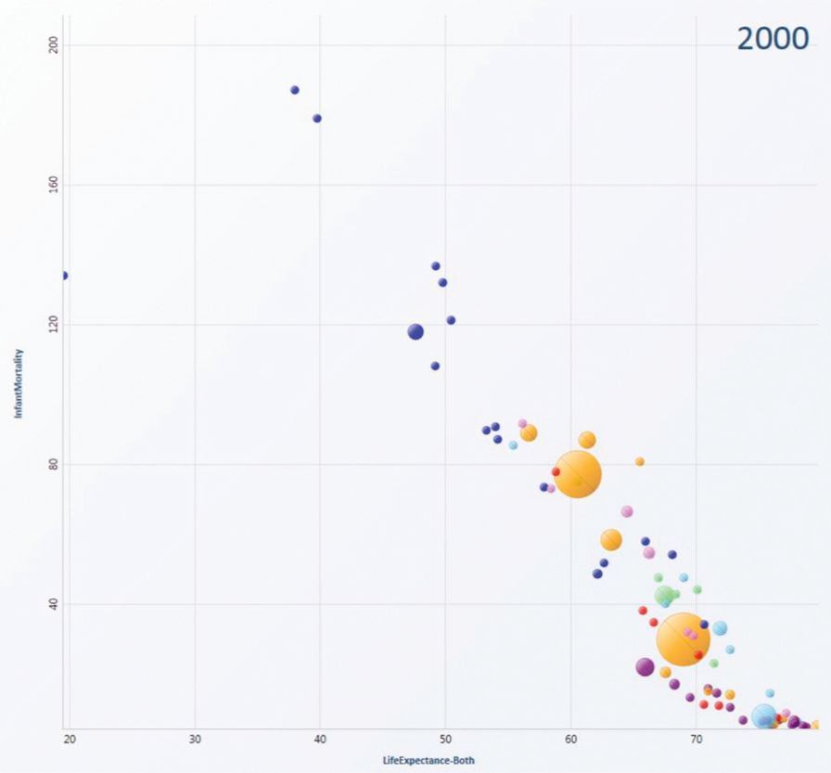
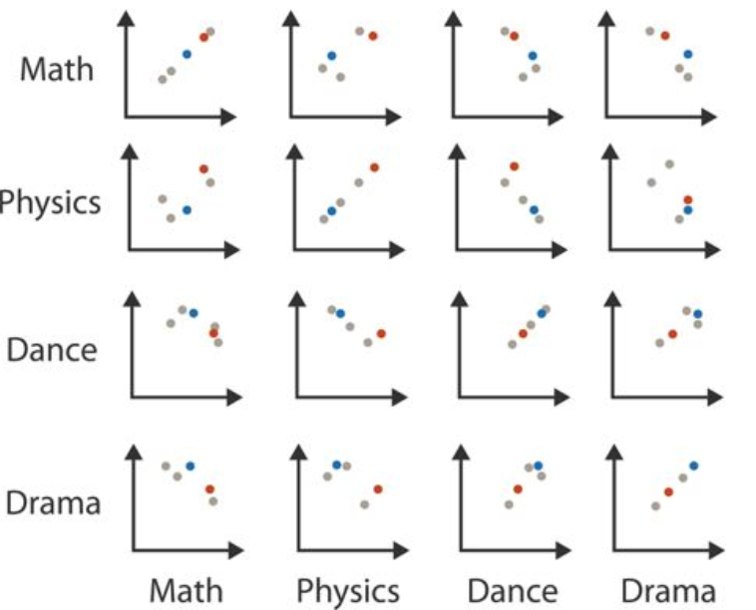
Example: Discover trends
What: Scatterplots 2 quantitative values
What: Scatterplot matrix
Pairwise quantitative values

Slide 11
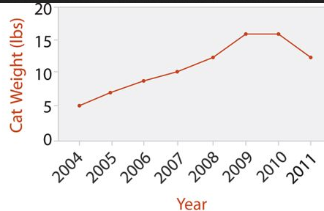
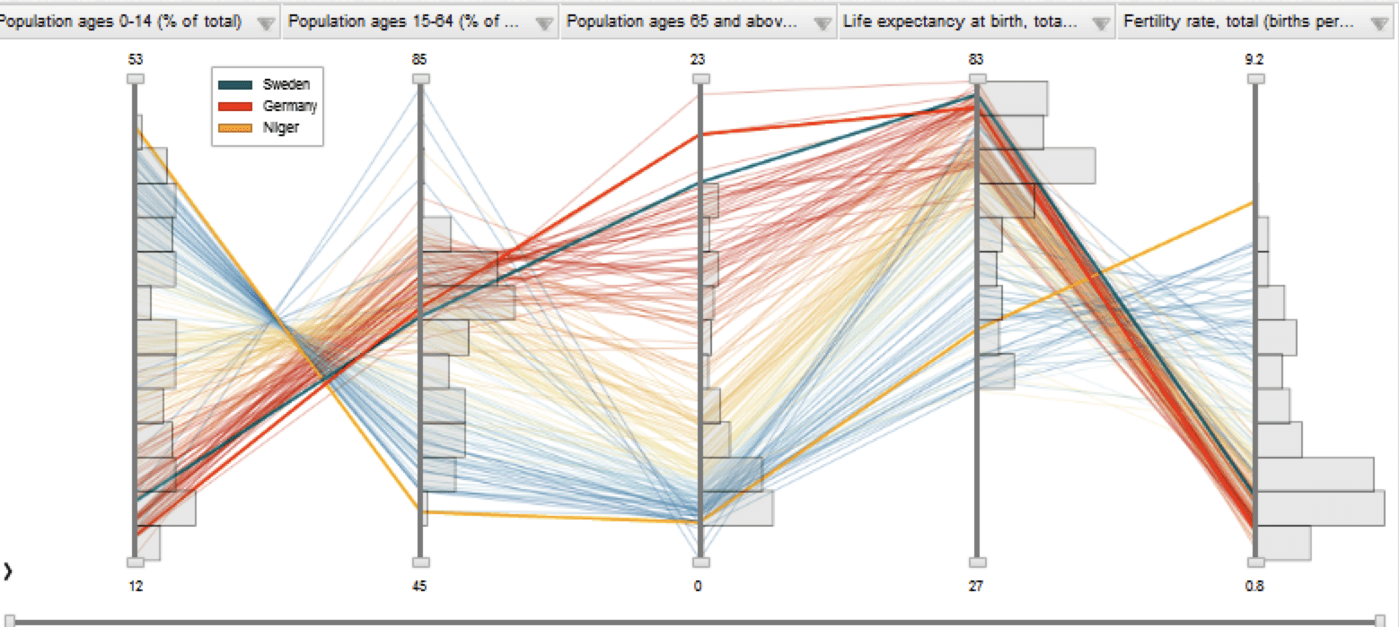
Example: Discover trends (cont'd)
What: Line Chart
Ordinal key + quantitative value
What: Parallel coordinates
Ordinal key + quantative values

Slide 12
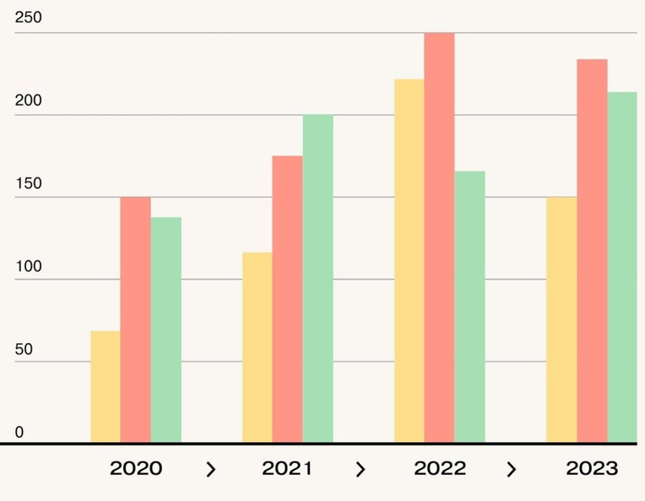
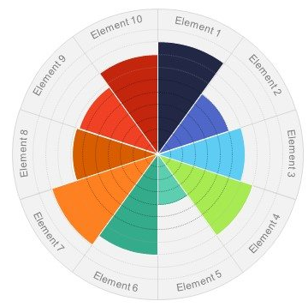
Example: Compare values
What: Bar chart
Ordinal key + quantitative value
What: Radial bar chart
Cyclic key + quantitative value

Slide 13
Working with data

Slide 14
Selection
A Collection of SVG or HTML elements
Selected using CSS selector
Used to
Change attributes
Add elements
Delete elements
Bind data
const svg = d3.select("#container")
.append("div")
.attr("id", "barChartSVG")
.append("svg")
.attr("viewBox", "0 0 800 4000")

Slide 15
Binding
Making D3.js reactive to the data
Procedure:
Select some elements
Define the data
Join with the data - updates the elements to fit the data
Format the new (and old) elements

Slide 16
Binding: Example
svg.selectAll("circle")
.data(data)
.join("circle")
.attr("cx", d => systolicScale(d.systolic))
.attr("cy", d => diastolicScale(d.diastolic))
.attr("r", d => countScale(d.count))
.attr("fill", d => colorScale(d.day))
.attr("stroke", "black")
.attr("stroke-width", 2)

Slide 17
Scaling (revisited)
Scaling is a mapping from data to displayed values
positions
colours
texts
…
It is used to display values consistently
It is mandatory for making things like axis on a scatterplot, and so on

Slide 18
Scaling: Linear Scaling
const systolicScale = d3.scaleLinear()
.domain([90, 160])
.range([100, 660])
const diastolicScale = d3.scaleLinear()
.domain([60, 110])
.range([500, 100])
const colorScale = d3.scaleLinear()
.domain([0, 3])
.range(["white", "lightgray", "darkgray", "gray"])

Slide 19
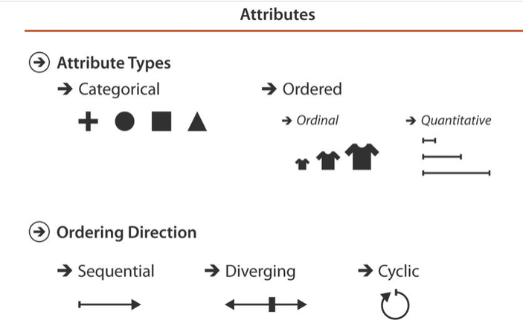
Scaling: Types of data

Slide 20
Types of scaling for quantitative data
d3.scaleLinear
d3.scaleLog / d3.scalePow
d3.scaleSequential
Continuous colour scaling for sequential data (grey -> red, etc.)
Better results than abusing linear
d3.scaleDiverging
Continuous colour scaling for diverging data (blue -> grey -> red, etc.)
d3.scaleQuantile / d3.scaleQuantize / d3.scaleThreshold
Discrete colour scaling using binning the data

Slide 21
Quantile, quantize, and threshold

Slide 22
Types of scaling for ordinal and categorical data
d3.scaleOrdinal
Manual 1-to-1 mapping of domain values to range values
d3.scaleBand
Mapping discrete domain values to intervals of range values
d3.scalePoint
Mapping discrete domain to equidistant range values

Slide 23
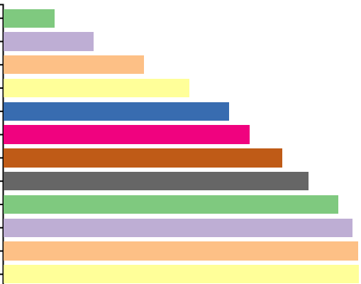
Band scaling (1)
const ageGroupScale =
d3.scaleBand()
.domain(ageGroups)
.range([100, 500])
.padding(0.2)

Slide 24
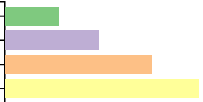
Band scaling (2)
const ageGroupScale =
d3.scaleBand()
.domain(ageGroups)
.range([100, 500])
.padding(0.2)

Slide 25
Examples and ideas

Slide 26
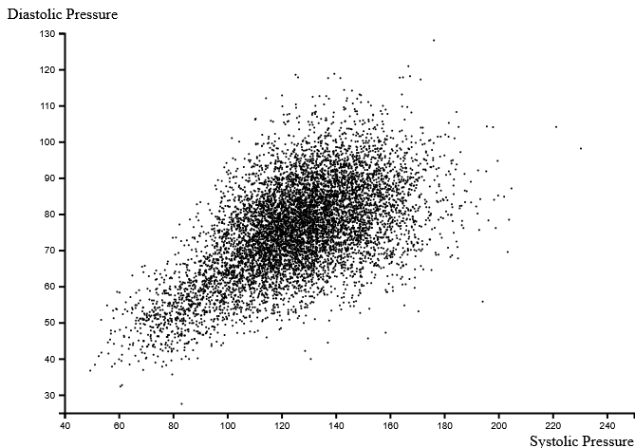
Discovering correlation: Scatterplot

Slide 27
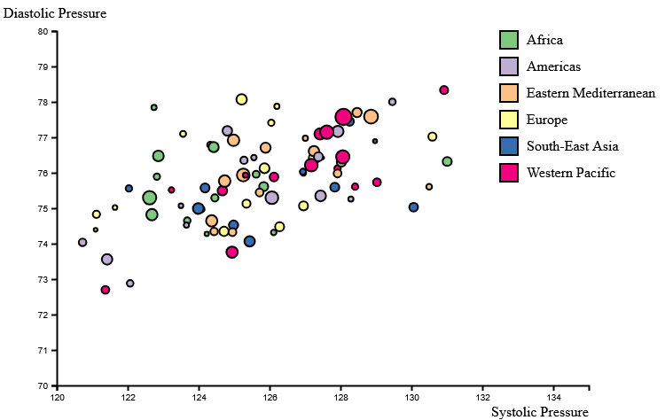
Comparing trends: Too much information buries the intent

Slide 28
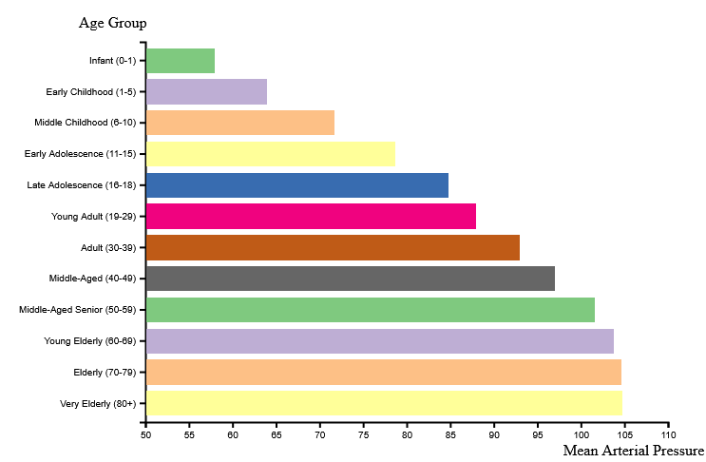
Discover trends: Bar Chart (But what about the colours?)

Slide 29
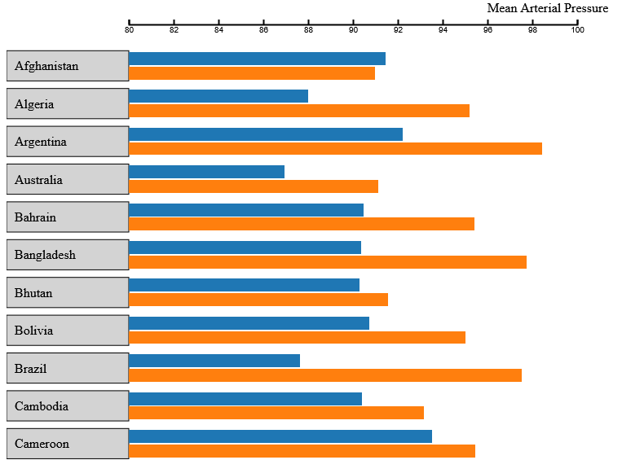
Compare values: Bar Chart

Slide 30
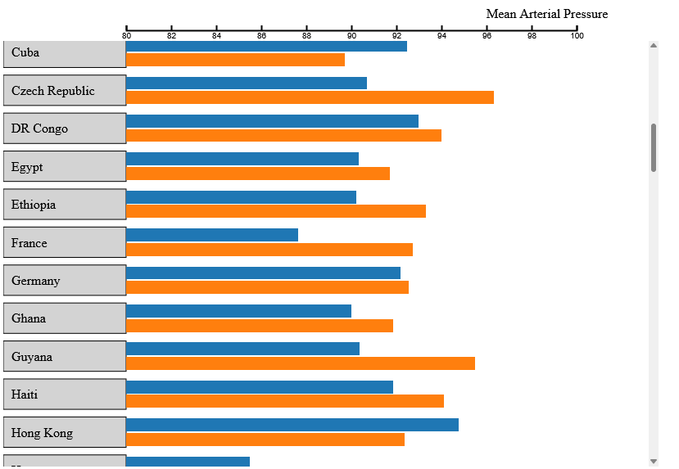
Gold-plating: Scrolling w/ fixed axis
const axisSVG =
d3.select("#container")
.append("svg")
.attr("viewBox", "0 0 800 60")
const svg = d3.select("#container")
.append("div")
.attr("id", "barChartSVG")
.append("svg")
.attr("viewBox", "0 0 800 4000")

Slide 31
Exercises
Try this on the Google Trends data
Introduction to hand-in 1 @11:40

